Slide 1
Stock assessment (a4a) European anchovy
(Engraulis encrasicolus) for GSA 17-18
H.Aymen, F.Calì , M.Kule, M. Rahuma, M.Gambin, A. Pierucci

Slide 2
Input data
Time series available: 1975-2015
Time series used: 2009-2015
Acustic survey index: 2009-2015

Slide 3
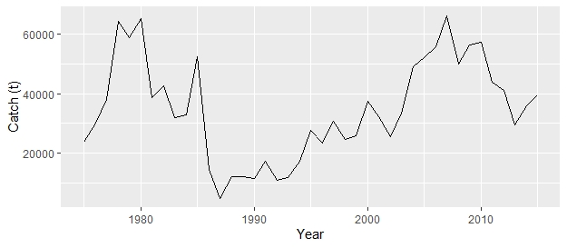
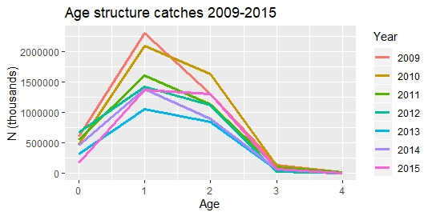
Data presentation
Total catches

Slide 4
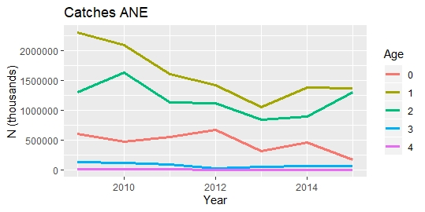
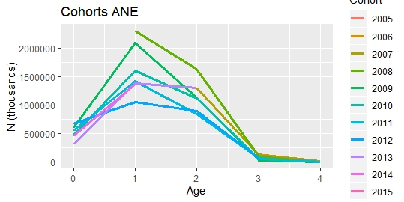
Data presentation

Slide 5
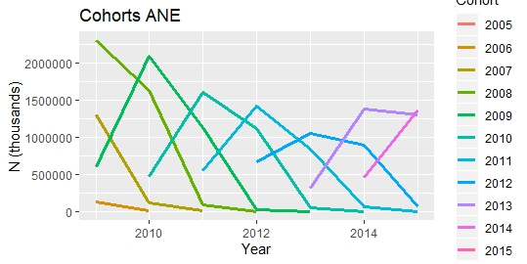
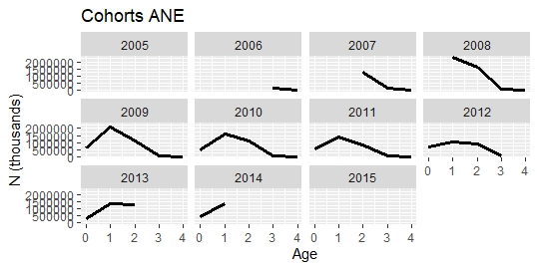
Data presentation

Slide 6
Model framework
Set the units
Set Catch = Discards + Landings
Harvest.spawn= 0.5 (July)
Mortality spawn= 0.5
Fbar between 1-3 (age 0 not selected)
Trim the stock file (2009:2015) to fit survey index (index shorter than the time series used)

Slide 7
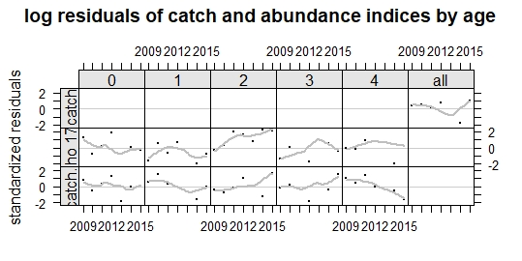
Model residuals

Slide 8
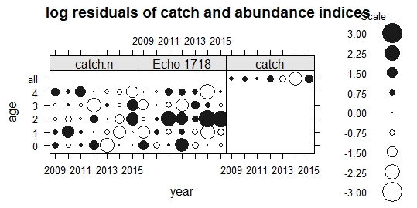
Model residuals

Slide 9
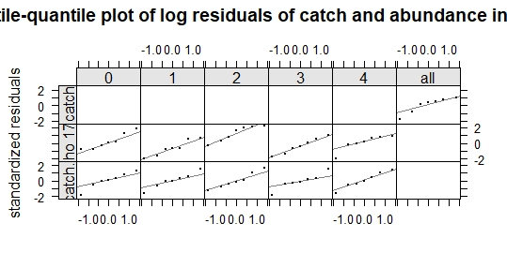
Model residuals

Slide 10
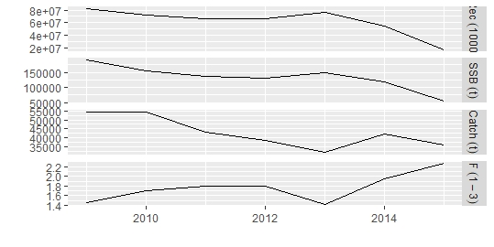
Model residuals

Slide 11
Reference points

Slide 12
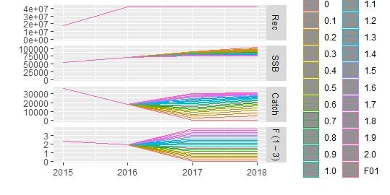
Short term forecast

Slide 13
Thank you for your attention

